Slide 1
Rome
Government
Imperialism
Society
Christianity

Slide 2
Government
Republic (500 B.C.E)
Senate
  Consuls (Two executives elected for one year terms)
  Patricians (Inherited position)
    Roman aristocracy (nobility)
  Plebeians (Elected position)
    Common people of Rome

Slide 3
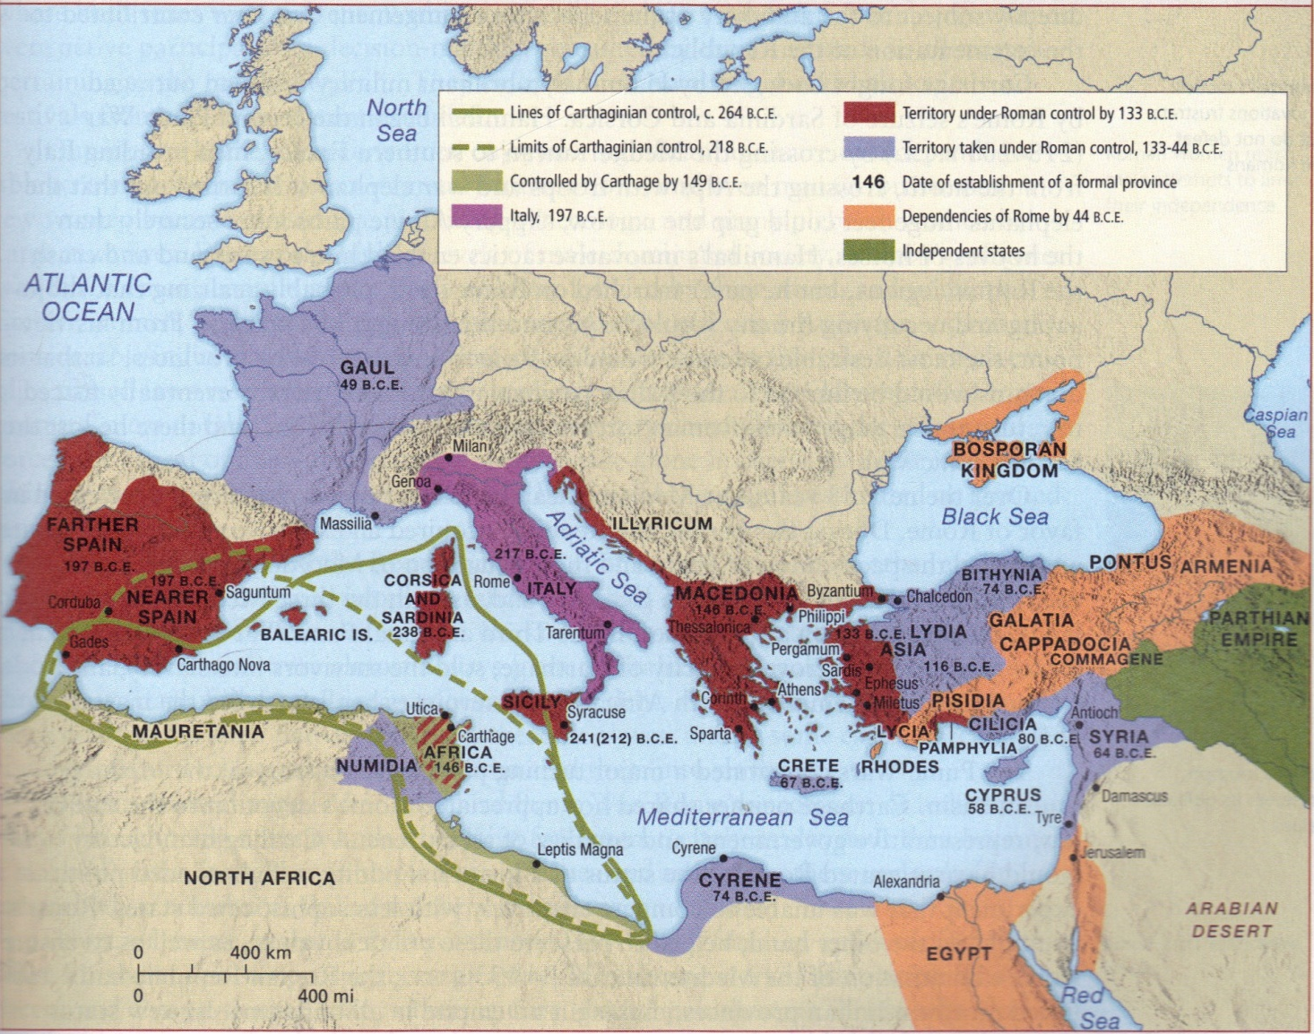

Slide 4
Imperialism
Punic Wars – Rome vs. Carthage
    First Punic War (264-241 B.C.E)
      Roma gains Sicily, Corsica, and Sardinia
    Second Punic War (218-201 B.C.E.)
      Carthaginian General Hannibal invades across Alps into Rome
      Rome gains Gaul (France) and Spain
    Final Punic War (149-146 B.C.E)
      Roman General Scipio Aemilianus seized and destroyed Carthage
Caesar (r. 60-44 B.C.E.)
Pax Romana
  Augustus (r.31 B.C.E.-14 C.E.)
    Imperator
    Roman Road System

Slide 5
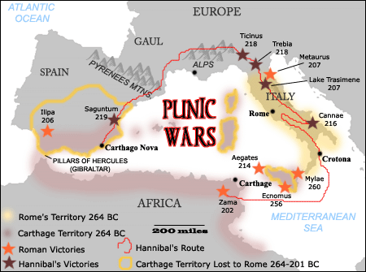

Slide 6
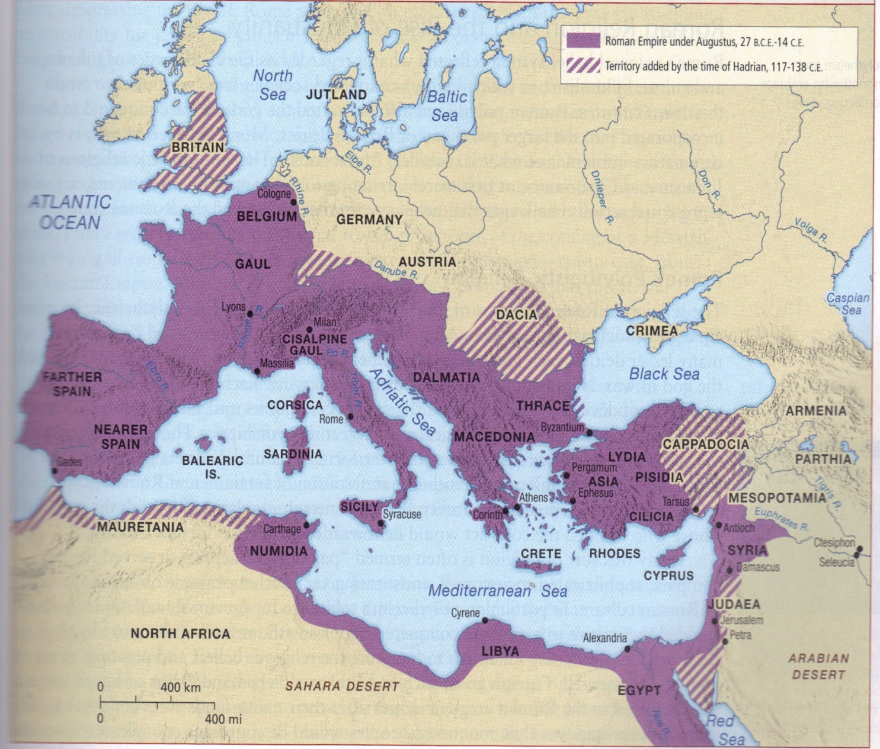

Slide 7
Society
Roman Law
  “Law of the People”
Social Life
  Paterfamilias
Social Conflict
  Struggle of the Orders
    Plebeians strike
    Law of the Twelve Tables
Religion

Slide 8
Christianity
Jesus of Nazareth (born around 4 B.C.E)
  Knowledge of Jesus
    Torah - teacher
    4 Gospels - divine
    Quran - prophet
  Jesus’s Teachings were Jewish
    His concept of the Messiah
      Pontius Pilate (r. 26-36 C.E.)
Peter
  Communion
    Eucharist

Slide 9
Christianity Cont’d
Paul of Tarsus (c. 1st century)
  Jew who had visions
  Claimed Jesus was the “son of God” – the Christ
    Paul became the first Christian
Hierarchy
  Pope, Bishops, and Priests
Constantine (r. 306-337 C.E.)
  Nicene Creed
    Canon Law
Augustine of Hippo (354-430 C.E.)
  City of God

